Slide 1

Project By: Soham Shah, Yash Shah & Amit Prajapati
Technical Stock Price Prediction & Financial News Analysis

Slide 2

Overview
Objective
Dataset
Feature Construction & Selection
Model Building
Accuracy and Predictions
Financial News Analysis

Slide 3
Objective

Slide 4

The Problem Statement

Slide 5
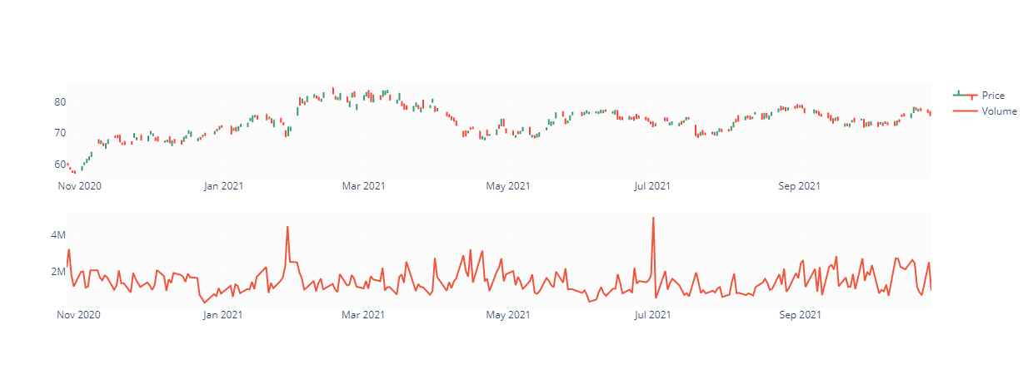
The Dataset
Stocks from Private Banking Sector: HDB
Timeframe: 1 years (2020-2021)
Extracted from Yahoo Finance API

Slide 6
Feature Construction
Exponential Moving Average
Simple Moving Average
Relative Strength Index
MACD
MACD Signal

Slide 7
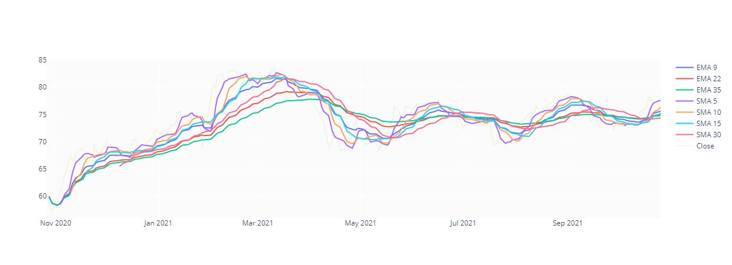
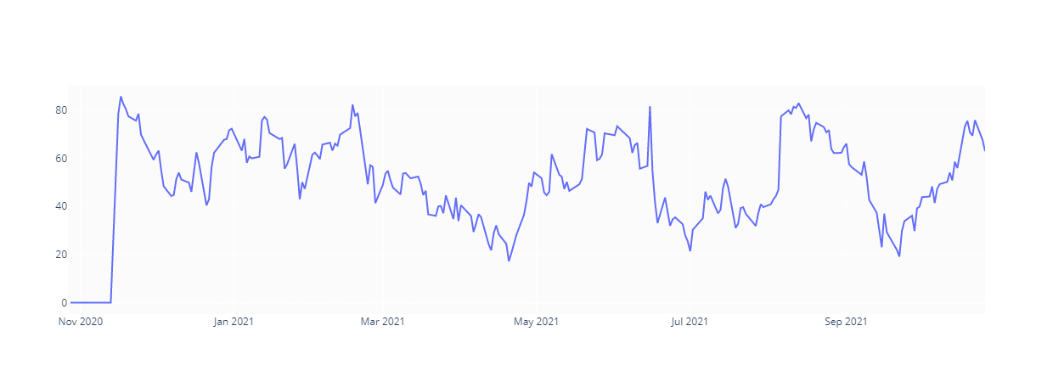
EMA, SMA & RSI

Slide 8
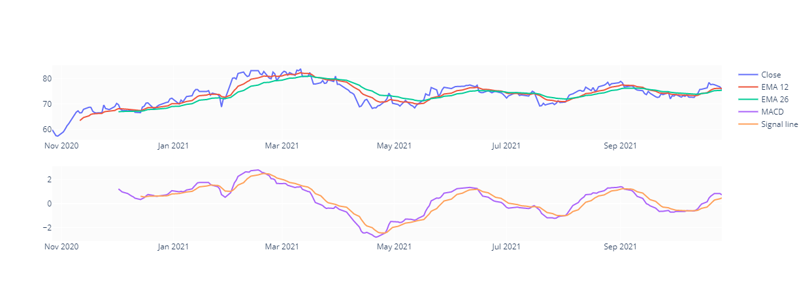
MACD

Slide 9
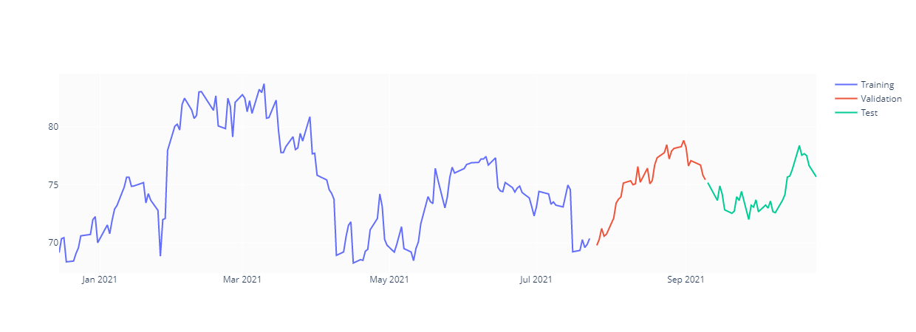
Dividing the Data

Slide 10
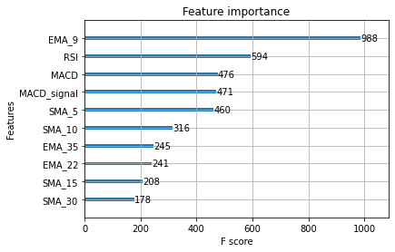
Feature Selection

Slide 11
Model Building
Model | MSE
xgb | 5.3771
rf | 3.2016
lr | 2.3278
xgb+lr+rf | 5.6098
lr+rf | 2.3111
xgb+lr | 3.4778
xgb+rf | 4.0803

Slide 12
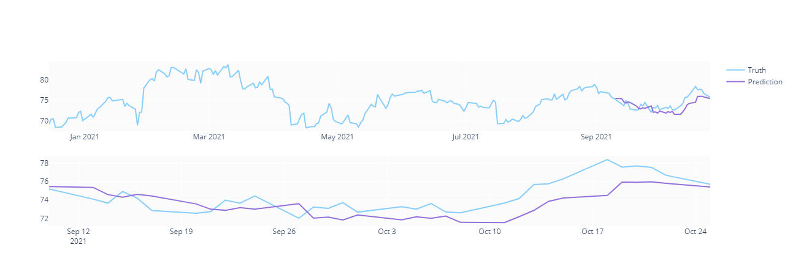
Predictions

Slide 13

Financial News Analysis

Slide 14

The Approach
Web Scrape News Headline Data
Use NLP techniques to Quantify the News
Test Correlation with actual Stock Prices
Calculate Average of Daily News

Slide 15
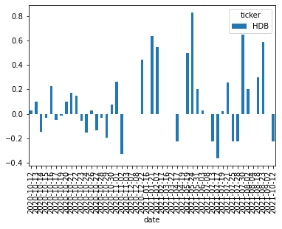
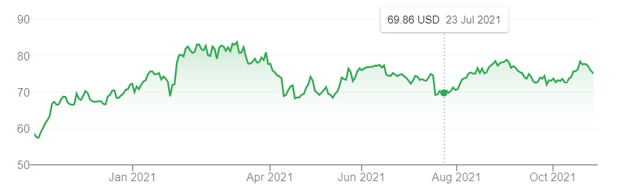
The Results

Slide 16

Thank You

